Slide 1
Lecture 2: Electronic Medical Records
CSCI6410/EPAH6410/CSCI4148
Jay Kumar (Jay.Kumar@dal.ca)
Finlay Maguire (finlay.maguire@dal.ca)

Slide 2
Learning Outcomes
Describe electronic medical/health record systems and the types of data they typically contain
Distinguish structured, semi-structured, unstructured text data
Describe approaches to searching text
Outline key steps in preparing text for analysis
Explain the general concept of learnt word embeddings
Explain how embeddings can be tuned/customised
Identify differences between named entity recognition, parts of speech tagging, and dependency parsing
Language Models
ChatGPT
Not covered: fuzzy search

Slide 3
What is an Electronic {Medical,Health} Record?

Slide 4
EMR are digital patient charts
Repository of patient information over time
Prone to fragmentation between primary / hospital care
Ideally contains all of a given patient’s details on:
Every encounter with health professionals (e.g., admitted to hospital)
Details and results of diagnostic testing and vitals (e.g., blood test, urine cultures etc.)
Diagnostic/therapeutic orders (e.g., Nil per os/NPO,
Procedures performed (e.g., appendectomy, PET-scan)
Medical note (e.g., primary physician, consult information)
Medication (e.g., antibiotics)
10.1038/s41746-018-0029-1

Slide 5
EMR data varies in structure
10.1038/s41746-018-0029-1

Slide 6
EMRs have a surprisingly long history
https://mayaberlerner.medium.com/a-brief-history-of-ehrs-c51a2125a247

Slide 7
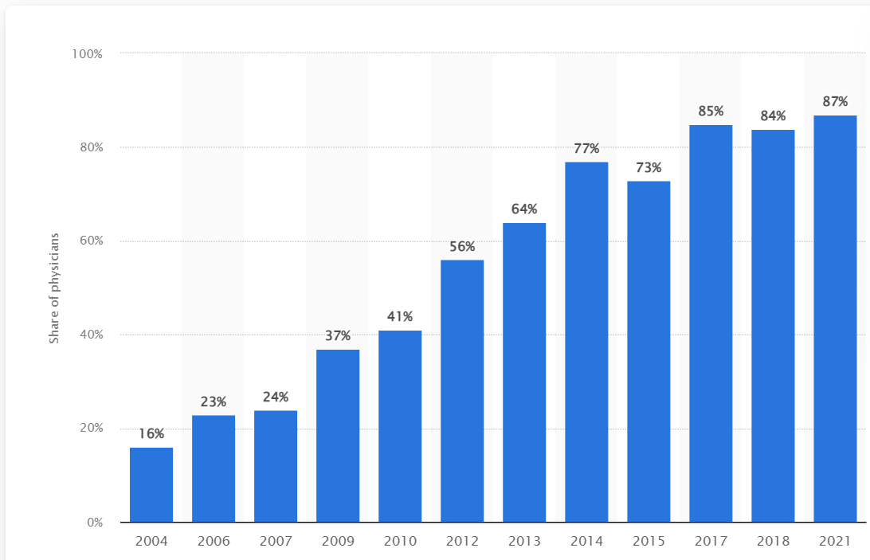
EMRs are common and increasing in use in Canada
Use of EMRs is common and increasing in Canada (2017-2021: 85% to 87%)
Primary care is main users (93%) compared to specialists (80%)
Atlantic regions have lowest use rate (74%)
Main features used:
Ordering diagonstic tests / accessing results
Prescription system with automatic warning of adverse drug interactions
Communication of discharge/consultation notes
Not used:
Clinical decision support (<27%)
Appointment scheduling (<21%)
AI/Machine Learning (<2%)
https://www.statista.com/statistics/788509/primary-care-physicians-usage-of-emr-in-canada/

Slide 8
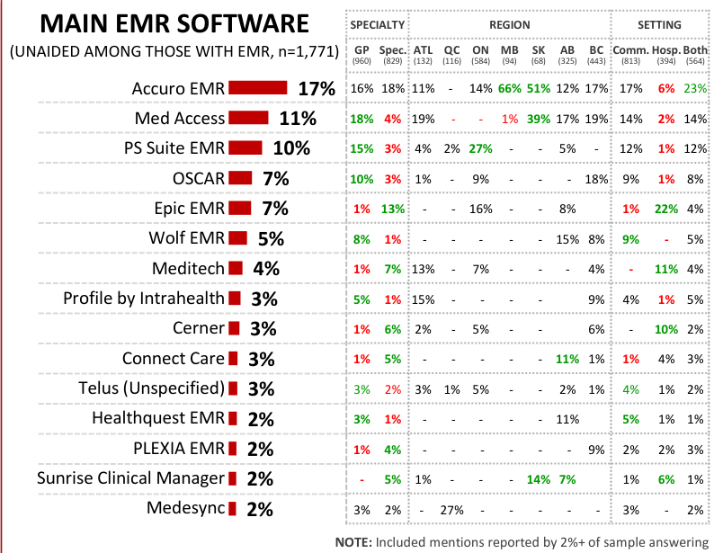
EMRs are common and increasing in use in Canada
Use of EMRs is common and increasing in Canada (2017-2021: 82% to 87%)
Primary care is main users (93%) compared to specialists (80%)
Atlantic regions have lowest use rate (74%)
Main features used:
Ordering diagonstic tests / accessing results
Prescription system with automatic warning of adverse drug interactions
Communication of discharge/consultation notes
Not used:
Clinical decision support (<27%)
Appointment scheduling (<21%)
AI/Machine Learning (<2%)
2021 National Survey of Canadian Physicians
https://www.cmaj.ca/content/187/1/E17

Slide 9
One Patient One Record Experience
Mix of Meditech, SHARE, individual silos
One Patient One Record
2014 December: Strategy Approval
2015 July:
NSHA CIO appointed to lead project
RFP solutions hired to monitor procurement process to lead OPOR
2016 March: Meeting moratorium
2016 May/December: Gevity/Allscripts NSHA meetings
2017 January: Request for Supplier Qualifications
2017 February: Submissions from 4 big firms (Epic, Allscripts, Cerner, Meditech) and 2 small ones (Evident, Harris Healthcare Group)
2017 June: Allscripts and Cerner named as only finalists based on 50 page RFSQ
2017 August: Evident complaint
....
???
…
~2022: One Patient One Experience

Slide 10
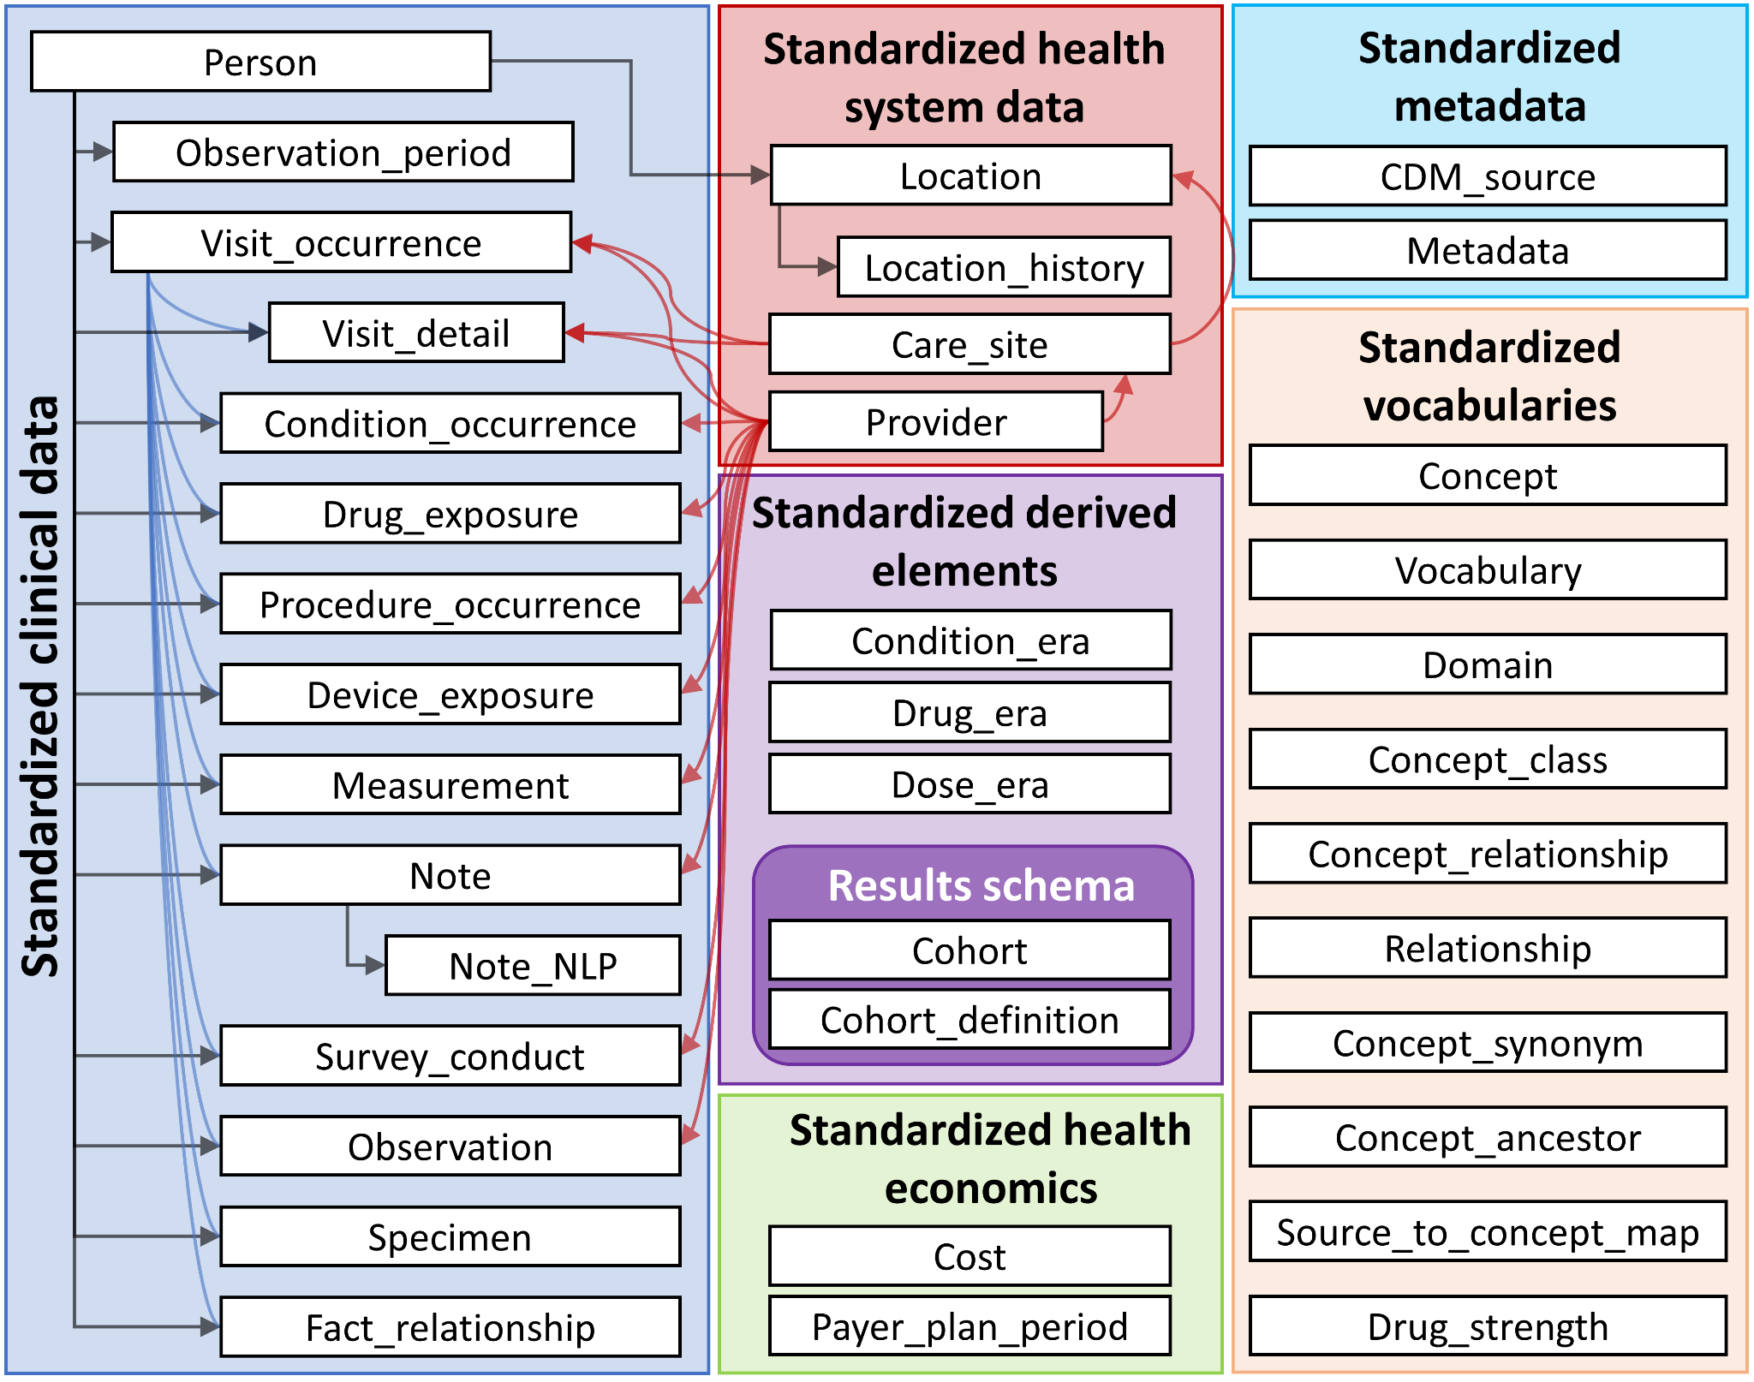
Reality: fragmented EMRs requiring difficult linkage
Interoperability is a competitive disadvantage
Standarised format and vocabulary for EMR data: Observational Medical Outcomes Partnership (OMOP) common data model
OHDSI tooling
Fast healthcare interoperability resources (FHIR)
https://ohdsi.github.io/TheBookOfOhdsi/images/CommonDataModel/cdmDiagram.png

Slide 11
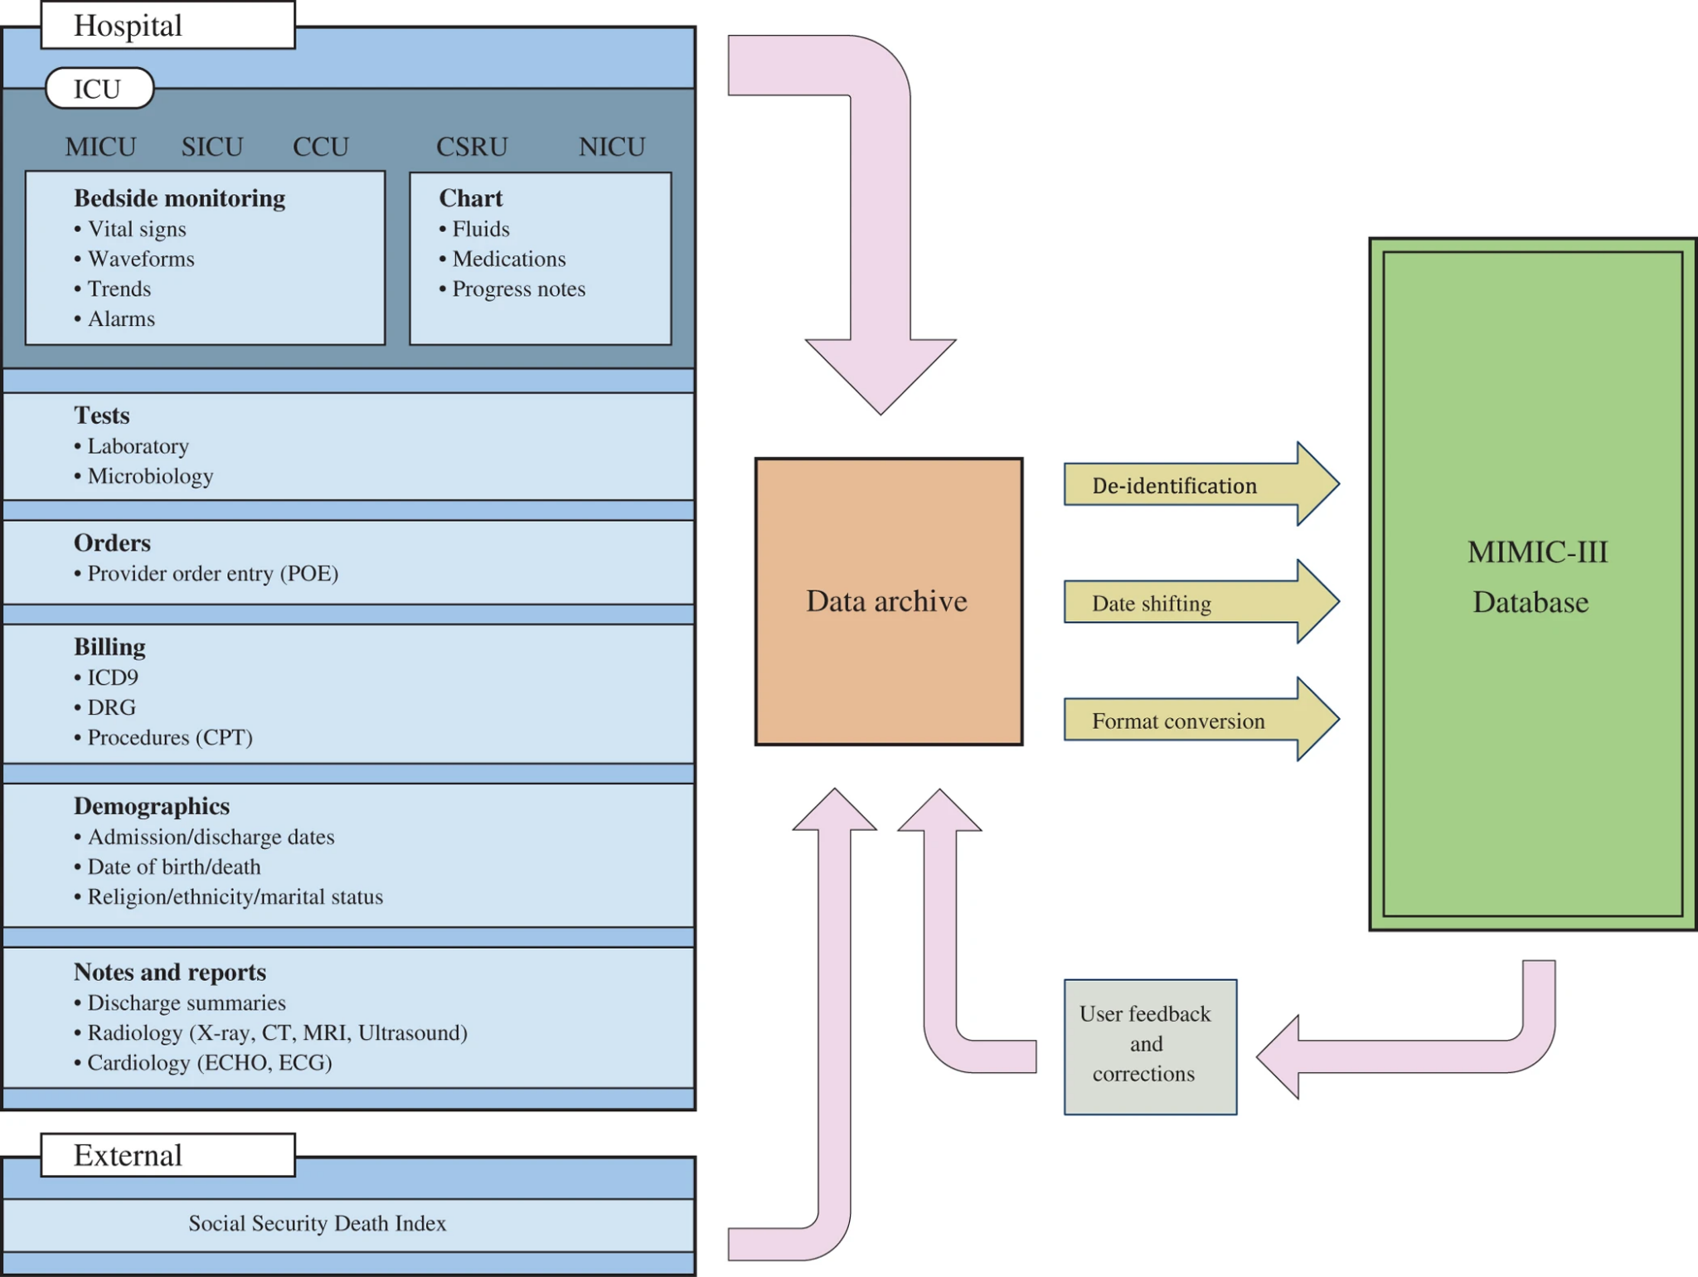
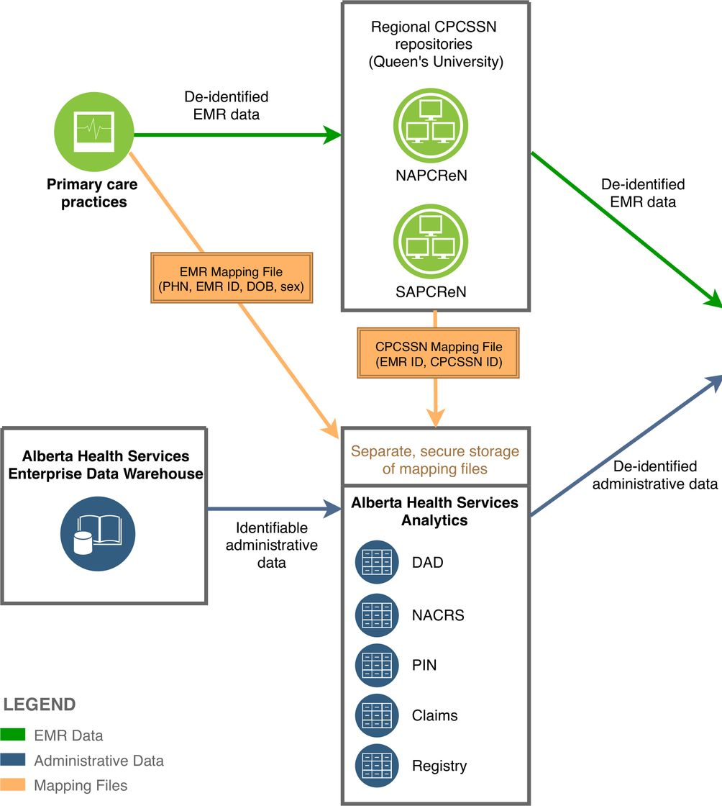
EMR datasets: MIMIC-.* / Canadian Primary Care Sentinel Surveillance Network / STARR
10.1038/sdata.2016.35
https://informatics.bmj.com/content/27/3/e100161
https://med.stanford.edu/starr-tools.html
Notes:
1) over forty thousand patients 2001 and 2012.

Slide 12
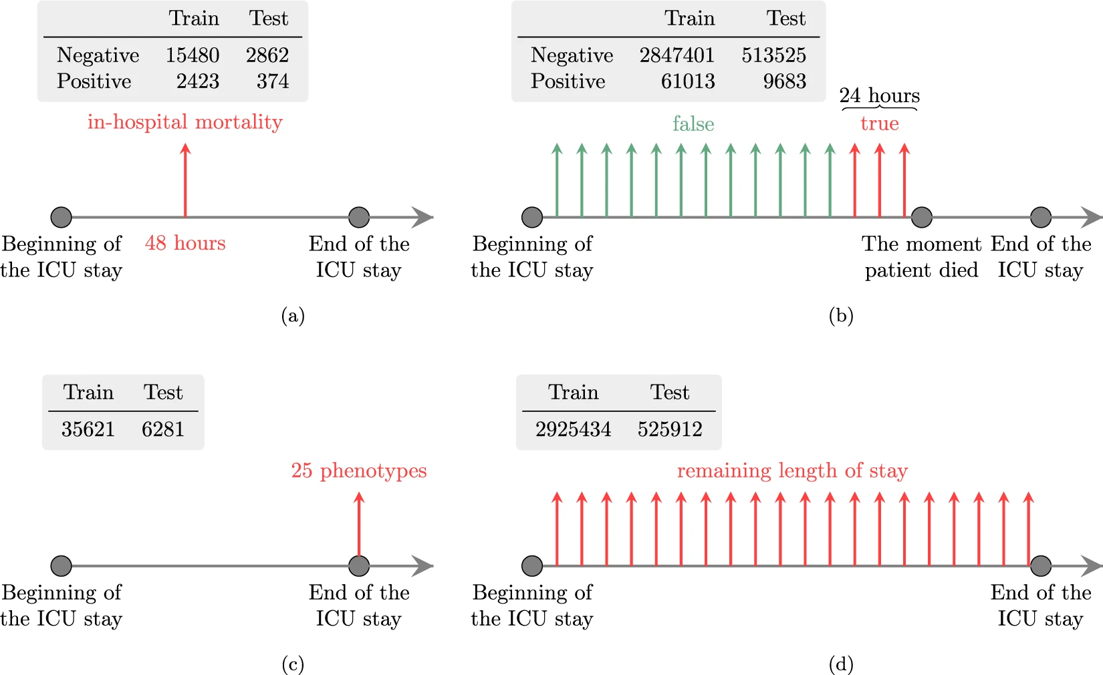
EMR allow us to ask complex questions

Slide 13
What kind of data is in an EMR?

Slide 14
Many types of data in EMRs
Discrete Physiological Parameters e.g., blood test metric measures
Diagnostic Imaging Data e.g., MRI image data
Physiological Sensor Data e.g., EKG/EEG signal data
Ordinal scale assessments e.g., frailty index
Text:
Structured text e.g., CPT/ICD-10 codes (V89.2XXA, S06.0)
Semi-structured Text e.g., {“Symptoms”: “Head pain, dizziness, emesis”, “Cause”: “Car crash”, “Diagnosis”: “Likely concussion”....}
Unstructured Text: “Patient was involved in a car crash and presented to the ER with pain, vomiting, and mild dizziness. Most likely they are concussed but should follow up with a head CT to confirm no other brain injuries”

Slide 15
Many types of data in EMRs
Structured records/text
The data tends to refer information in “tables”

Slide 16
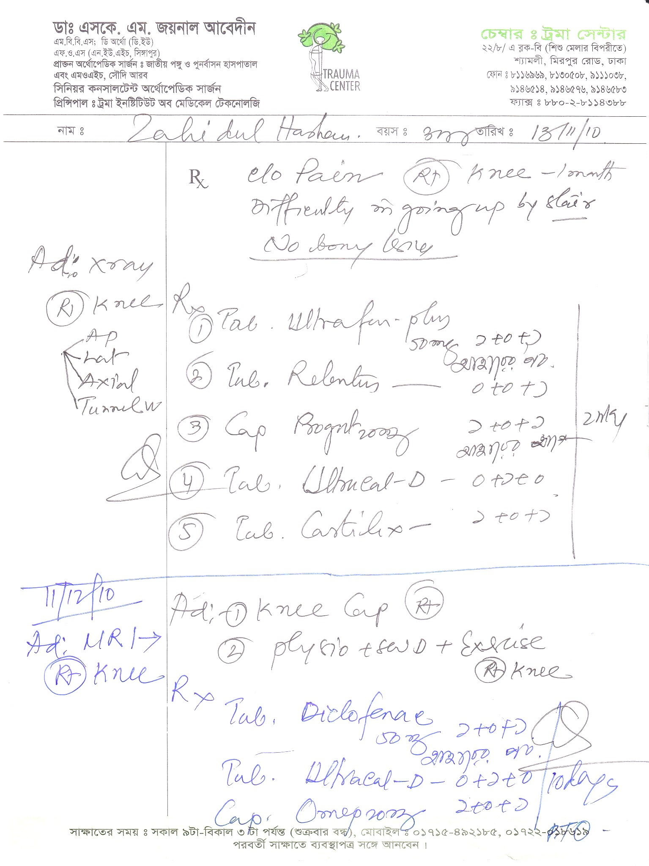
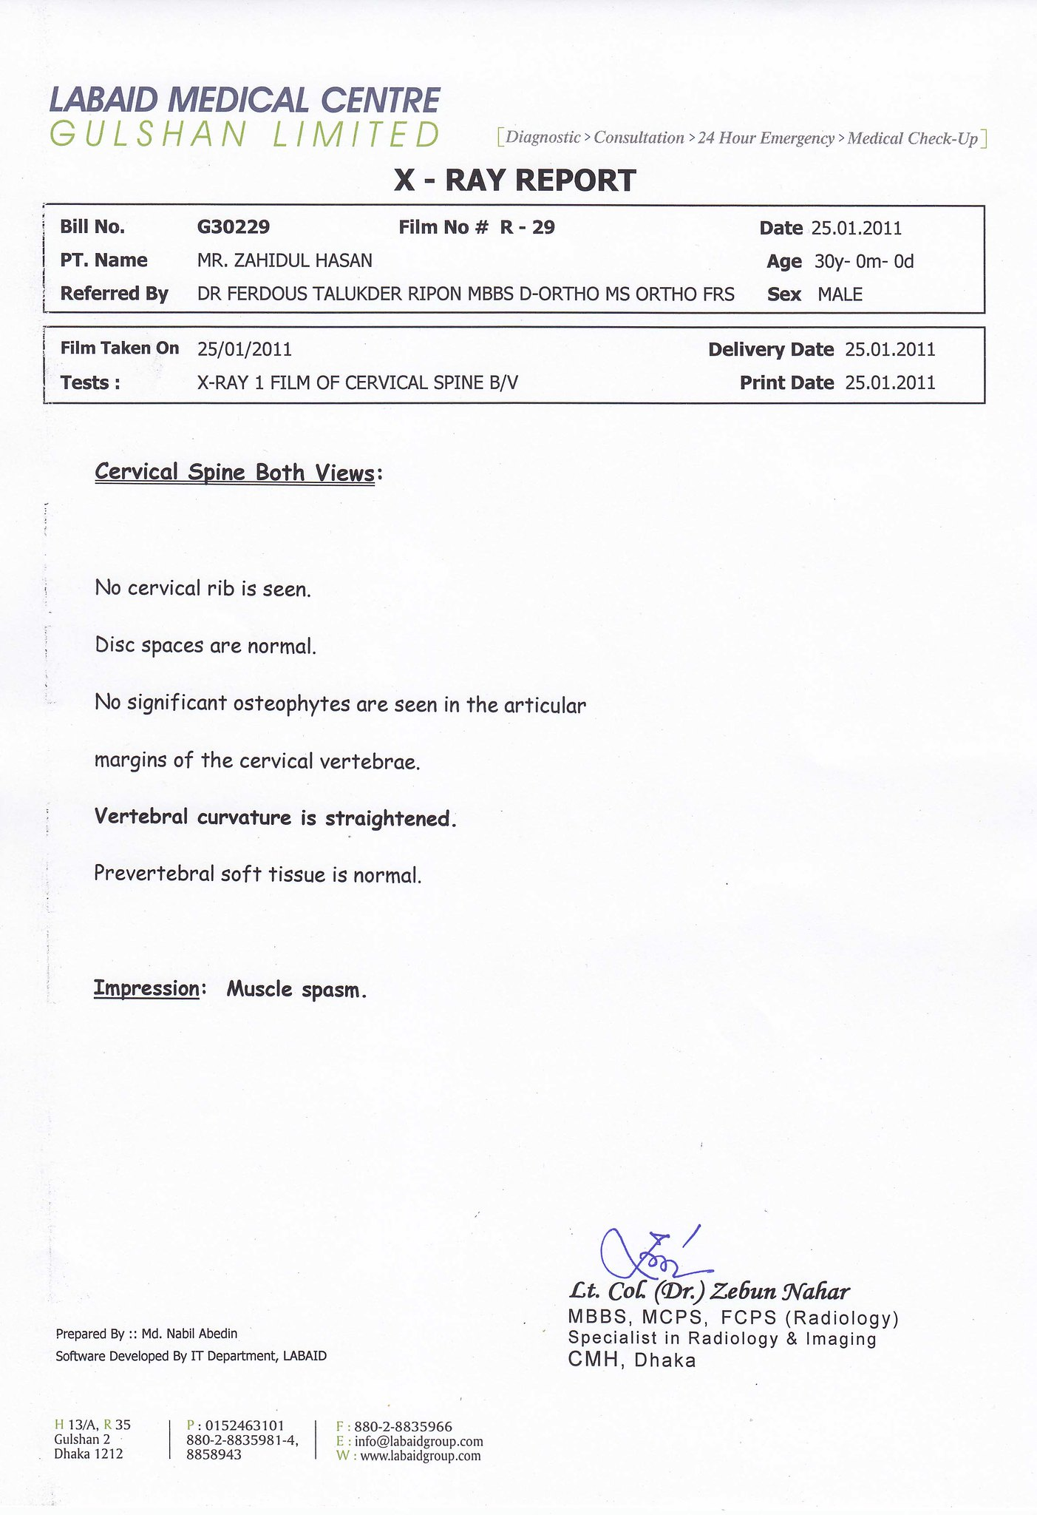
Many types of data in EMRs
Unstructured records/text
data refers information in free text

Slide 17
Many types of data in EMRs
Semi-structured records/text
Unstructured text inside the structured data
“PatA1223”: {“Symptoms”: “Head pain, dizziness, emesis”, “Cause”: “Car crash”, “Diagnosis”: “Likely concussion”....}

Slide 18
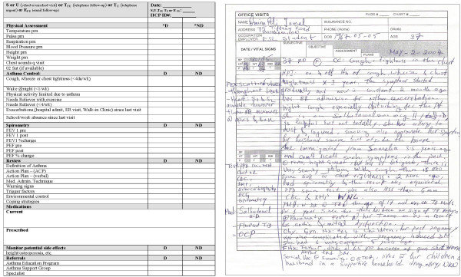
Medicine loves unstructured text
Unstructured text is and will forever remain the primary form of communication in medical clinical settings.
Highly flexible, efficient, and expressive across a range of communication contexts for medicine.
Mainstay of charts, notes, consults, discharge summaries, procedure/operative logs.

Slide 19
Unstructured text is challenging
English language especially has many synonymous and highly flexible grammatical structure.
Medical english has even more synonymous:
Bilateral salpingectomy
Salpinoectomy
Fallopian Transection
Fallopian Tubectomy
Fallopian Tubal Ligation
Tubal ligation
Tubal sterilisation
Tubal
CPT58600
Now add typos and transcription errors!
Difficult to search
Difficult to summarize
Difficult to analyze

Slide 20
So how would we do something like this?

Slide 21
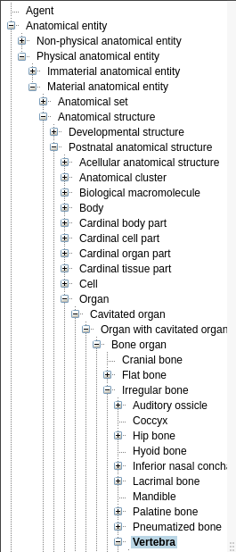
Natural Language Processing!
NLP is any computer-based method that handles/augments/transforms natural language so that it can be represented for computation.
Approximate synonyms: text mining, text processing, computational linguistics
Example problem:
1. “Find every medical note in the EMR related to the spine”
2. Identify key search terms e.g., “back”, “spine”, “vertebra”, “lumbar”, “neck”, “cervical”, “thoracic”, “sacrum”, “coccyx” (expertise, ontology/vocabularly)
3. Search for EMR for these terms

Slide 22
Let’s start simple: searching text

Slide 23
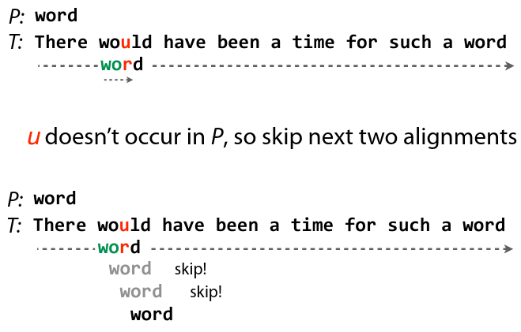
Searching for exact matches: Ctrl-F
Many exact match algorithms with varied properties (typically ctrl-F will mix and match them in a context-dependent way).
Scan over all text and look for things that exactly match your query
Make things more efficient: Boyer-Moore/Knuth-Morris-Pratt/Rabin-Karp etc.
https://www.cs.jhu.edu/~langmea/resources/lecture_notes/04_boyer_moore_v2.pdf

Slide 24
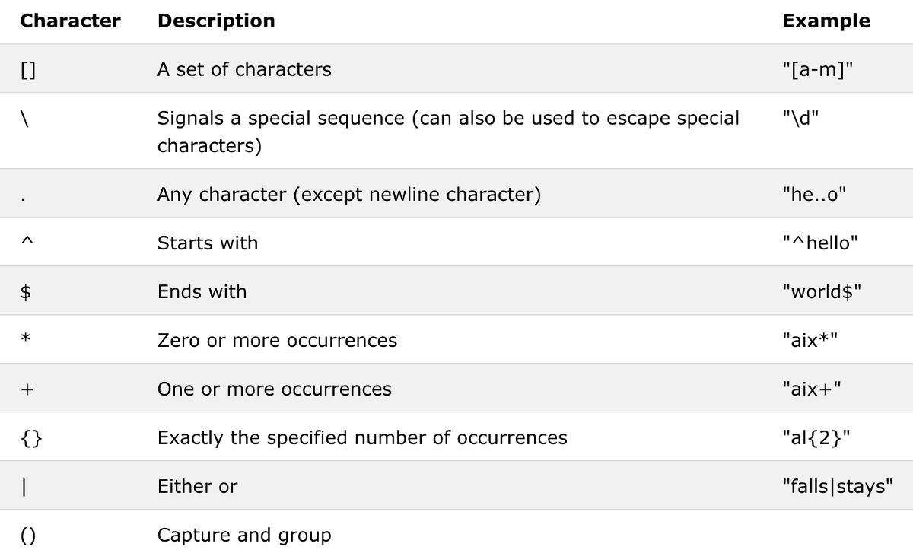
More flexible searches for keywords: Regular Expressions
Need to find “spine” and “spinal” = spin(a|e)l?
Can also be used to capture words/before after: \w+\sspin(a|e)l?\s\w+
Builds on lots of well-developed CS theory
You have a problem, you use regex, you now have 2 problems

Slide 25
Regular expressions can get very complicated!
RCF5322 Email validation regex:
(?:[a-z0-9!#$%&'*+/=?^_`{|}~-]+(?:\.[a-z0-9!#$%&'*+/=?^_`{|}~-]+)*|"(?:[\x01-\x08
\x0b\x0c\x0e-\x1f\x21\x23-\x5b\x5d-\x7f]|\\[\x01-\x09\x0b\x0c\x0e-\x7f])*")@(?:(?
:[a-z0-9](?:[a-z0-9-]*[a-z0-9])?\.)+[a-z0-9](?:[a-z0-9-]*[a-z0-9])?|\[(?:(?:(2(5[
0-5]|[0-4][0-9])|1[0-9][0-9]|[1-9]?[0-9]))\.){3}(?:(2(5[0-5]|[0-4][0-9])|1[0-9][0
-9]|[1-9]?[0-9])|[a-z0-9-]*[a-z0-9]:(?:[\x01-\x08\x0b\x0c\x0e-\x1f\x21-\x5a\x53-\
x7f]|\\[\x01-\x09\x0b\x0c\x0e-\x7f])+)\])

Slide 26
Can we make the text easier to search instead?

Slide 27
Initial stages of text processing
Tokenization
Segmentation
Stop words
4. Normalization

Slide 28
Splitting text into words: Tokenizing
Breaking text into smaller units
letters, morpheme, words, sentences, paragraphs
Example:
Process is known as tokenisation (a subset of segmentation)
Units you break into are known as tokens:
“He had spinal contusions”
He
had
spinal
contusions
He
had
spinal
contusions

Slide 29
Splitting text into words: Tokenizing
Process of Tokenization may change with respect to each Language
For English, easy approach:
split on spaces
Has to be fast (finite state automata)
Challenges: punctuation can matter (e.g., 01/02/22), not all languages use spaces, may want to treat multiword expressions (MWE) as tokens e.g., “New York”, “bilateral salpingo-oophorectomy”, “ice box”/”ice-box”/”icebox”

Slide 30
N-gram Tokenization
1-gram
e.g., “He had spinal contusions.”
[“he”, “had”, “spinal”, “contusions” ]
2-gram
[ “he had”, “had spinal”, “spinal contusion”]
N-gram tokenization technique is used to capture semantics and context

Slide 31
Splitting sentences: Sentence Segmentation
We have text paragraphs and each sentence should be separated
Sentences are delineated on punctuation: “.”, “?”, “!”
Often we want to segment phrases/clauses, more challenging:
“Patient presented to ER with pain/confusion, most likely as a sequelae of a head injury” ->
[“Patient”, “presented”, “to” “ER”, “with”, “pain”, “confusion”]
[“most”, “likely”, “as”, “a”, “sequelae”, “of”, “a”, “head”, “injury”]

Slide 32
Normalisation
simplifying the words of the language
e.g., “Ph.D.”, “PhD”, “phd” probably shouldn’t be counted differently
Case folding: collapse everything to lowercase (although case can often be informative: “US” vs “us”)
Lemmatization: identifying words with common root (lemma) e.g., “operation” and “operations” -> “operation”; “brought” -> “bring”
“Surgeon is performing surgical procedures” -> “Surgeon be perform surgical procedure”
Requires morphological parsing - splitting stems (central morpheme) from affixes (modifying/adidtional meaning)
Lemmatization is difficult : alternative = stemming
Remove final affixes e.g., remove “-ing, -s, -ational, -sses”
“This was not the correct operation” -> “Thi wa not the correct operat”

Slide 33
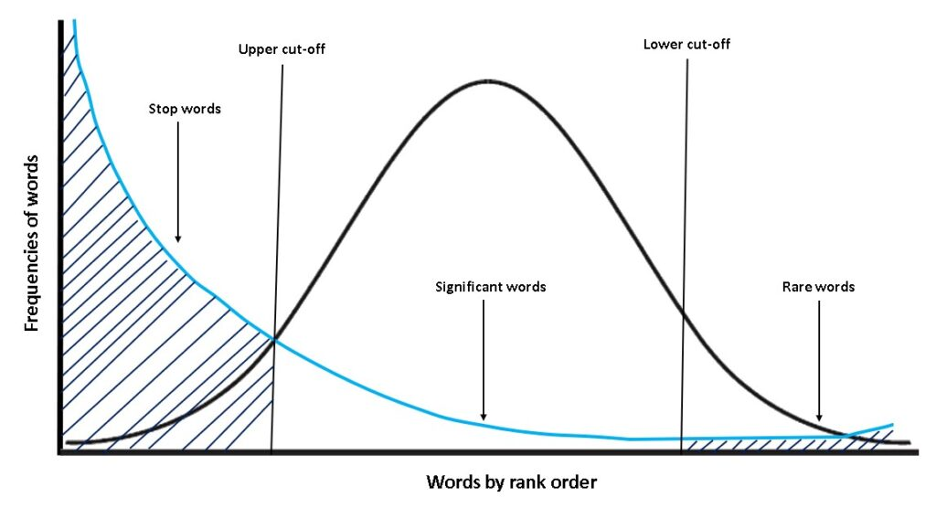
Normalisation
Stop Words:
High frequent tokens
Individual non-informative tokens
E.g., “to”, “from”, “by”
While using single word tokenization, stop words are removed to balance the statistics of vocabulary

Slide 34
Hashing Tokens / Indexing
How to index terms for fast processing
Mapping tokens to codes
Posting list
TOKEN | HASH
Spine | 01
Car | 02
tree | 03
$$⋮$$
Doc#1
01 | 15 | 23 | 84
Doc#2
03 | 09 | 10 | 24
Vocabulary/ Dictionary

Slide 35
Hashing Tokens / Indexing
can be N-dimension representation
How to index terms for fast processing
Mapping tokens to codes
Posting list
TOKEN | HASH
Spine | 01
Car | 02
tree | 03
$$⋮$$
Doc#1
01 | 15 | 23 | 84
Freq
1 | 1 | 2 | 1
Doc#2
03 | 09 | 10 | 24
Freq
2 | 1 | 1 | 1
Vocabulary/ Dictionary

Slide 36
Hash-based text search
can be N-dimension representation
See if query hashes are present in note hash sets
‘Spine’ in Doc#1
Posting list
TOKEN | HASH
Spine | 01
Car | 02
tree | 03
$$⋮$$
Doc#1
01 | 15 | 23 | 84
Freq
1 | 1 | 2 | 1
Doc#2
03 | 09 | 10 | 24
Freq
2 | 1 | 1 | 1
Vocabulary/ Dictionary

Slide 37
How to extract relationship between terms?

Slide 38
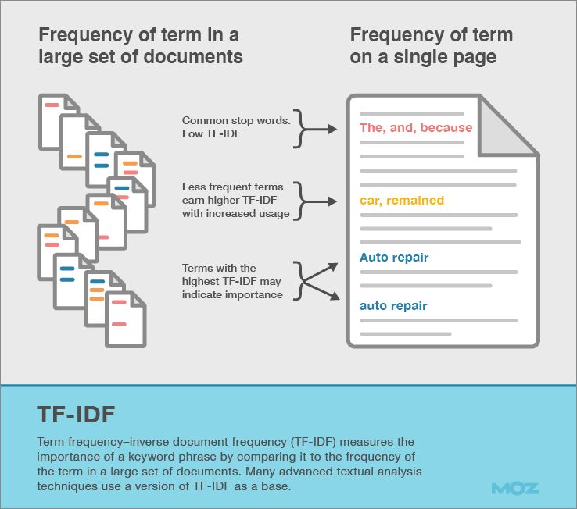
Identify frequently used terms
Find highest TF-IDF terms
Filter them manually for new search terms
Apply prior search approaches (or any of the fuzzy matching approaches)
Among other unsupervised approaches (e.g., following material)
$$IDF=\log{\frac{N}{|\{d∈D:t∈d\}|}}$$

Slide 39
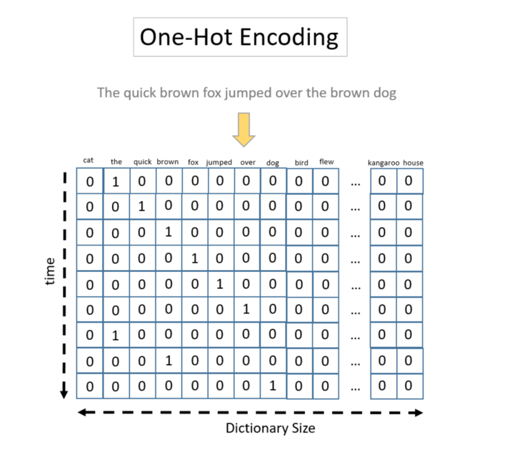
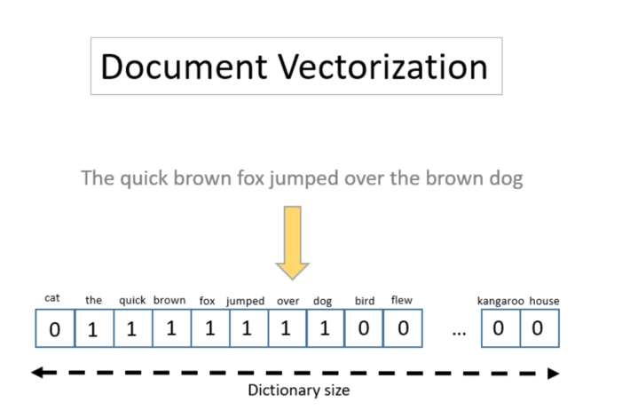
Encoding text as a vectors
Equal size document representation
One-hot encoding
Very large vectors with even moderate vocabulary size
Very sparse vectors (lots of 0s)
Sum over columns for each note to get a vector representation of the document instead (TF-IDF is a normalisation of this representation)

Slide 40
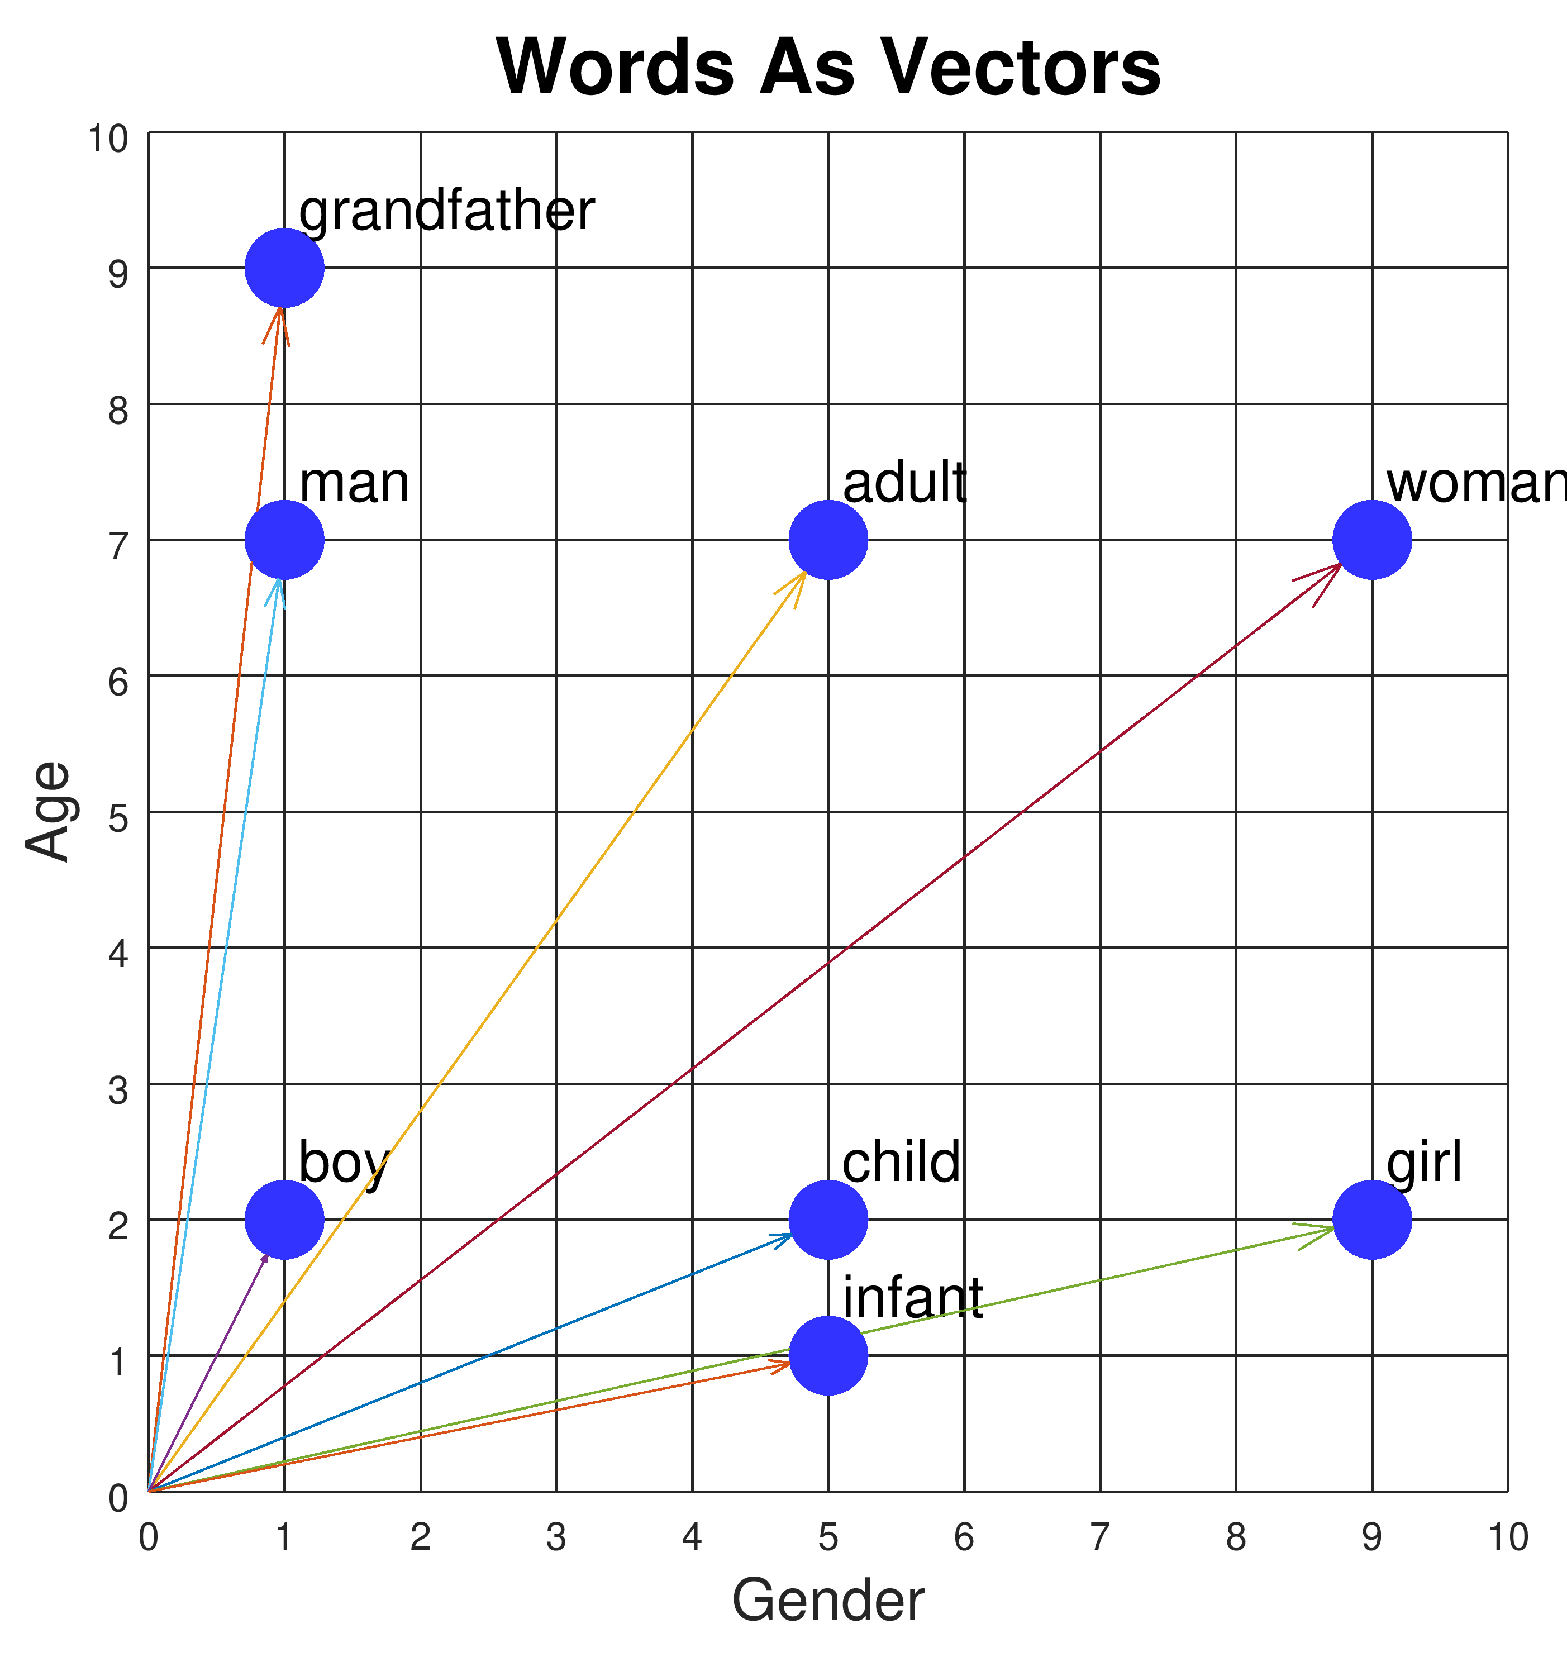
word embeddings
low-dimensional representations of high-dimensional data
Preserve meaningful relation between terms
E.g., “father” and “son” very related, “father” and “notebook” are not
How to learn the relationship between terms
https://www.cs.cmu.edu/~dst/WordEmbeddingDemo/tutorial.html

Slide 41
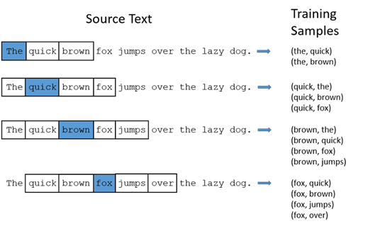
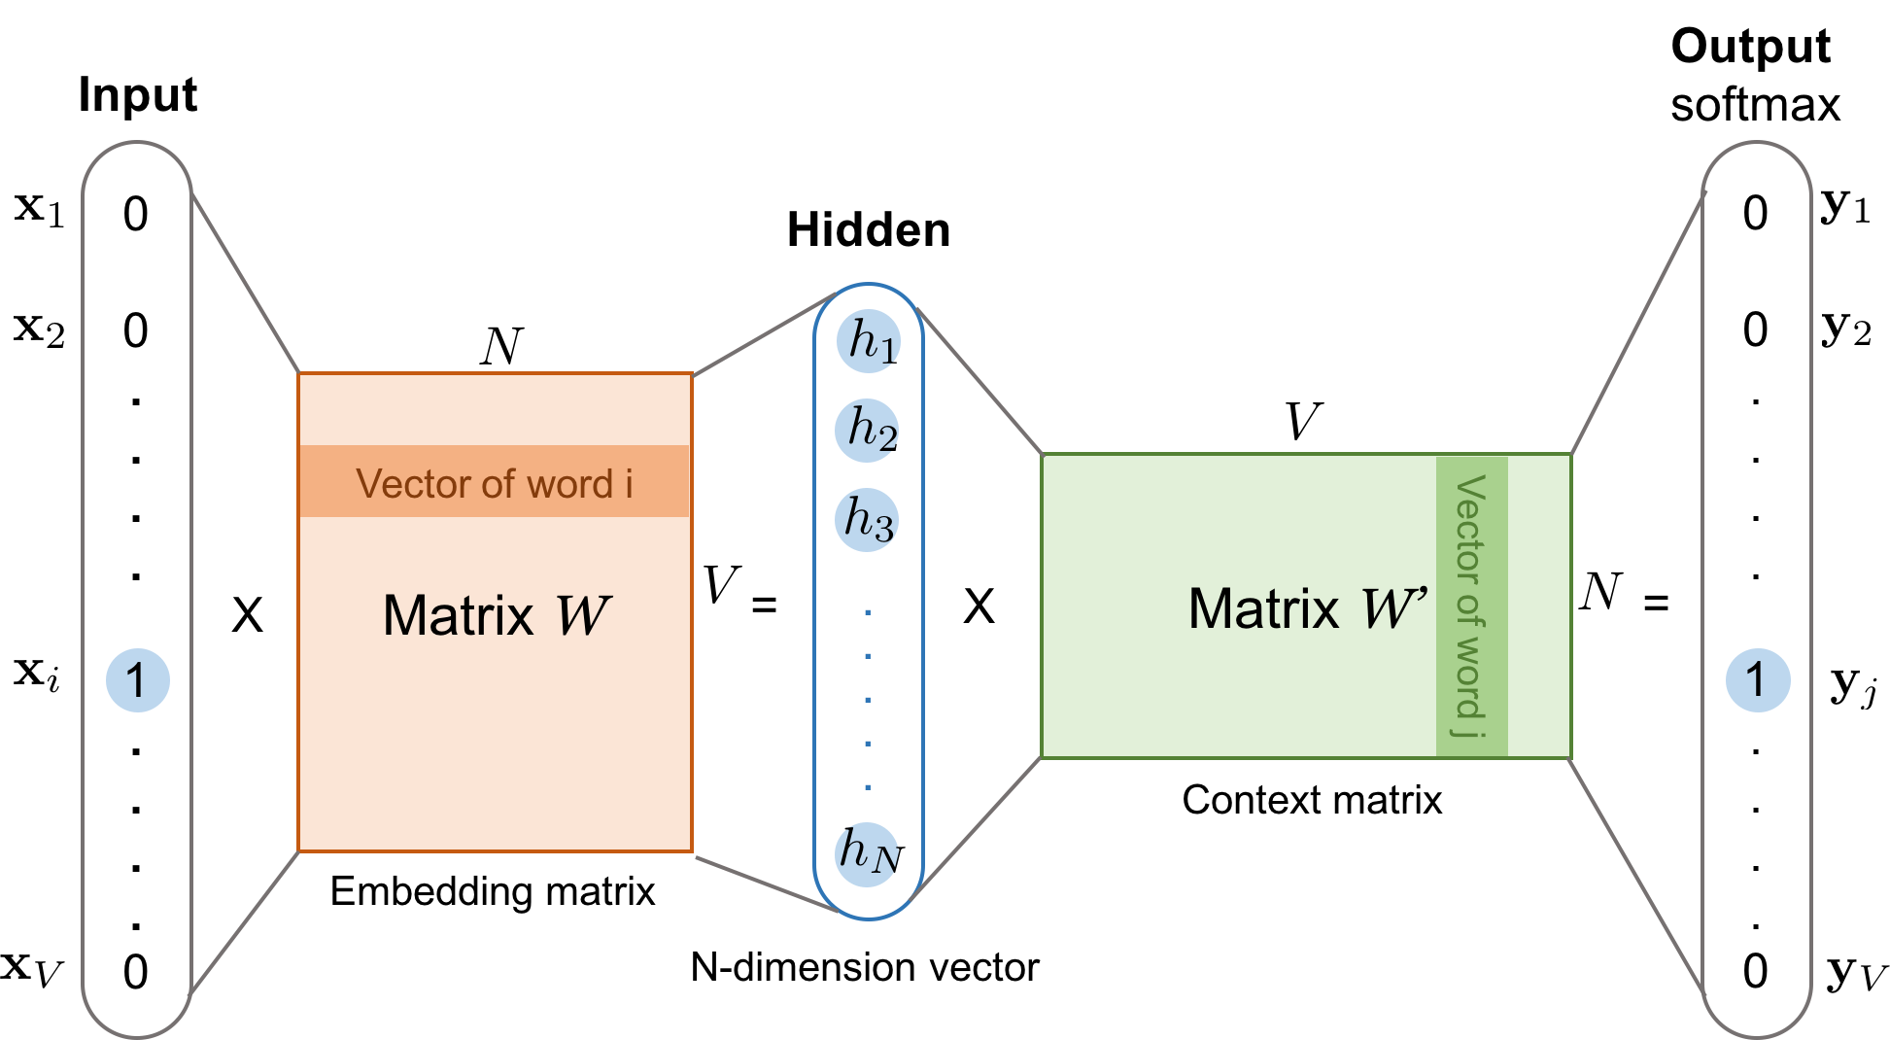
Learned word embeddings
Word2Vec -> GloVe -> ELMo -> BERT -> ERNIE -> GPT-3/Megatron/T5
https://lilianweng.github.io/posts/2017-10-15-word-embedding/

Slide 42
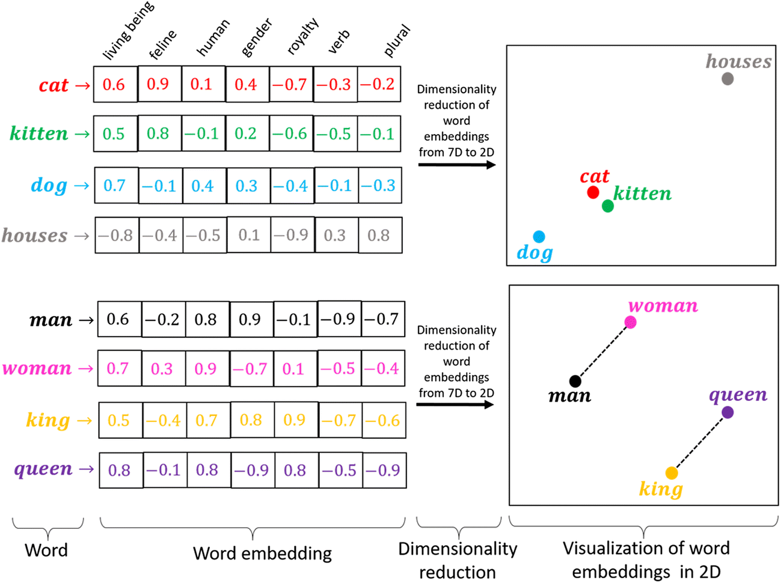
Learnt embeddings are powerful

Slide 43
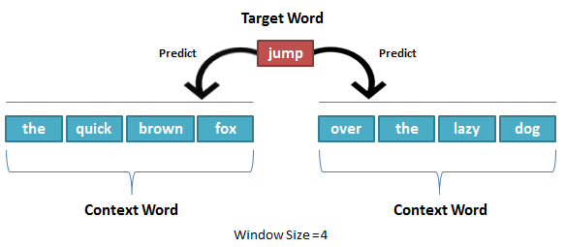
Reducing the dimensionality of these vectors
Standard dimensionality reduction methods struggle
Text has semantic AND syntactic aspects/similarity
We want to find a lower dimensional embedding that captures these aspects
“You shall know a word by the company it keeps (Firth, J. R. 1957:11)”
“The meaning of a word is its use in the language” (Wittgenstein)
Can we use the CONTEXT of a given word to find a meaningful vector representation?
Answer:
Byte-Pair Encoding
N-grams
Learned Word Embeddings

Slide 44
Custom embeddings and fine-tuning
Same approach can be used beyond just words:
Med2Vec
EHR2Vec
BioALBERT
Corpora used to create embedding may not be a good fit for specialised text (i.e., EMRs aren’t representative of the internet at large… we hope).
Repeat training on your data but initialise with pre-trained weights

Slide 45
How can we use these for different tasks?

Slide 46
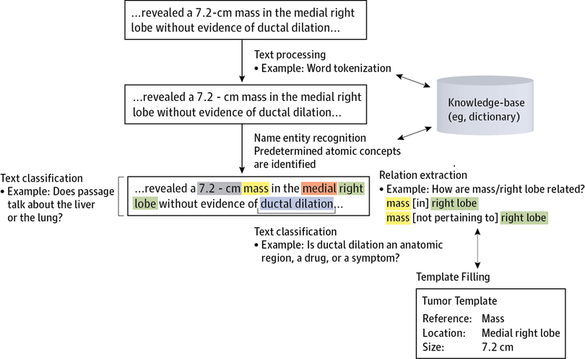
More complex operations require additional steps
10.1001/jamaoncol.2016.0213

Slide 47
More complex operations require additional steps
10.1001/jamaoncol.2016.0213

Slide 48
More complex operations require additional steps
10.1001/jamaoncol.2016.0213

Slide 49
Identifying tokens referring to things: Named Entity Recognition
Identify specific categories of entities e.g., places, times, anatomy
Lots of pre-trained approaches/vocabularies
Text classification problem => requires some way to encode text to a numerical vector

Slide 50
Train classifier on labelled medical text (e.g., ontology) = Named Entity Recognition
10.1001/jamaoncol.2016.0213

Slide 51
Train document classifier on EMR notes labelled by organ => Text classification
10.1001/jamaoncol.2016.0213

Slide 52
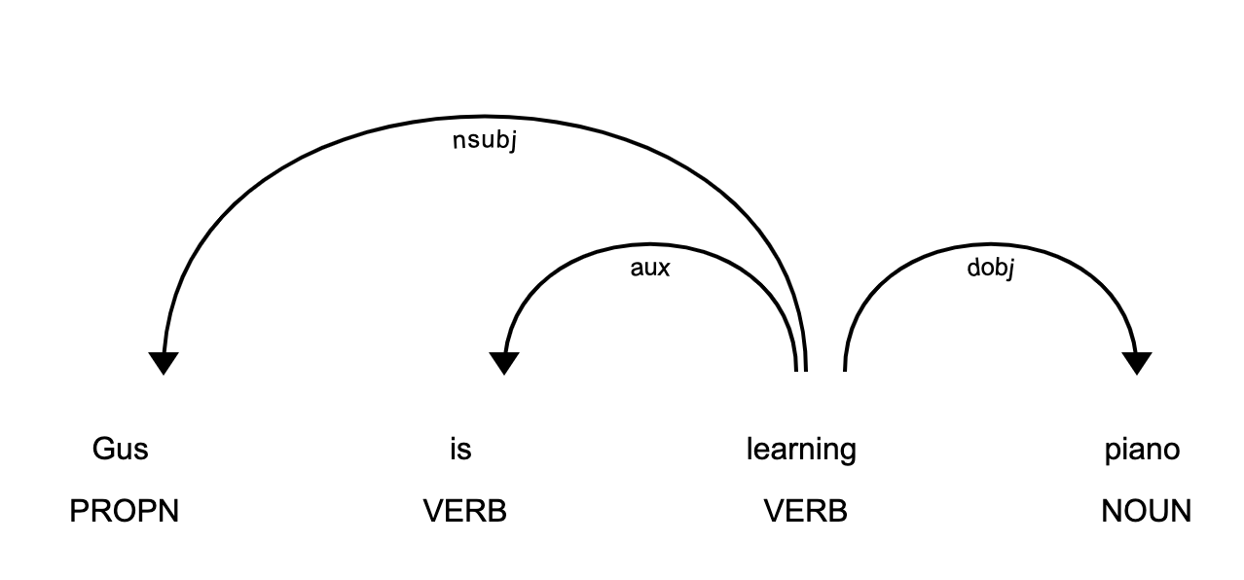
Use classifier trained to identify parts of speech and their relations (previously HMMs)
10.1001/jamaoncol.2016.0213

Slide 53
What if we don’t know the query terms in advance?

Slide 54
Language Models
A function that puts a probability measure over strings drawn from some vocabulary.
Probability distribution of word sequences (i.e, words, phrases, sentences)
P(w) = P ($w_{1}$, $w_{1}$, … $w_{k}$)
Repeat training on your data but initialise with pre-trained weights
Follows the Markov Chain process

Slide 55
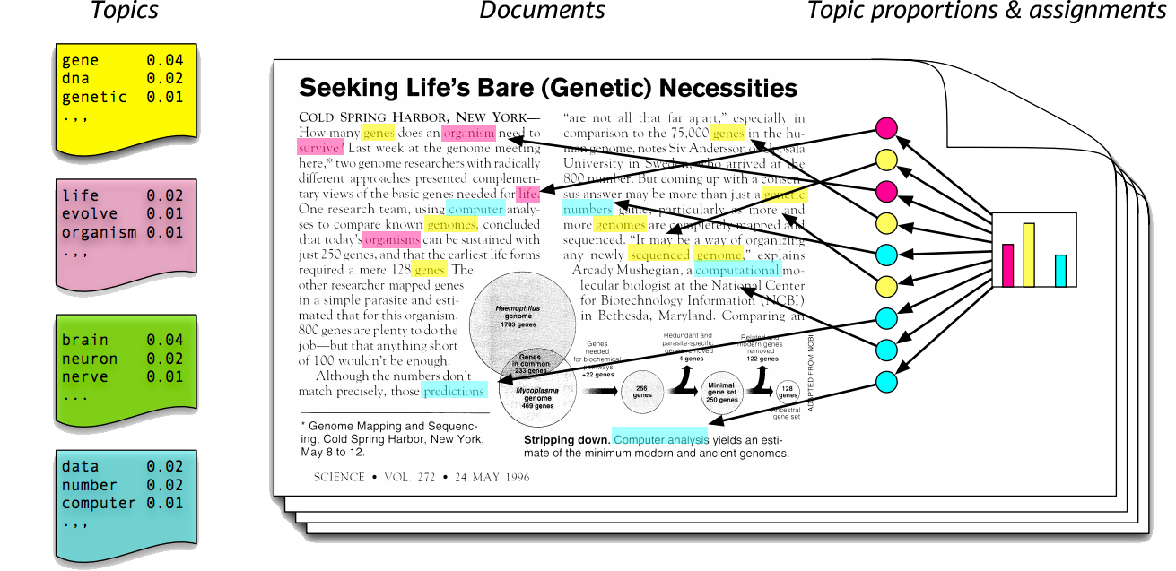
Language Models
Latent Dirichlet Allocation
Extract n topics from a given corpus

Slide 56
Can a AI model learn and generate information?

Slide 57
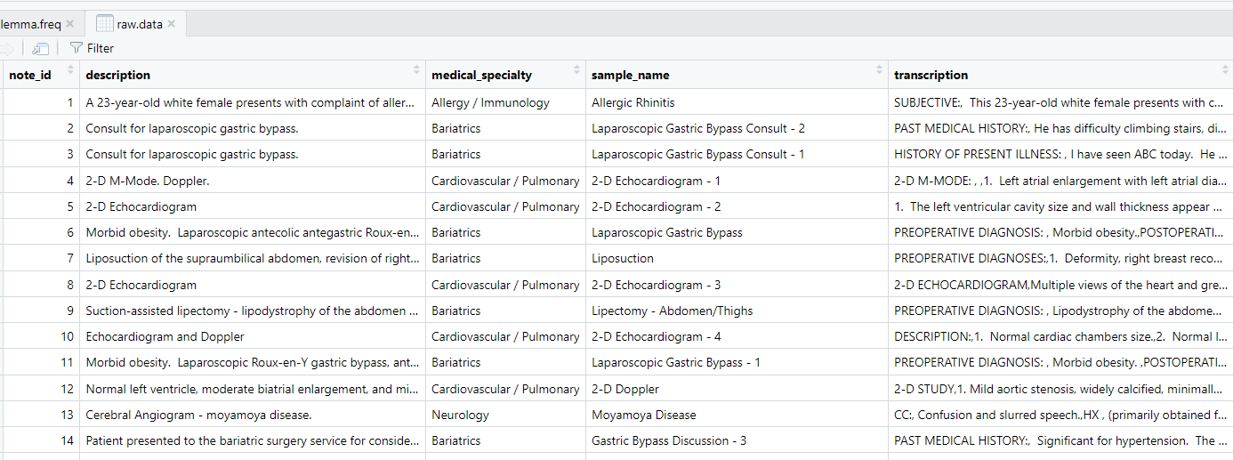
Chatgpt
ChatGPT is an AI language model
It is designed to generate human-like responses in natural language conversations.
Let us ask something

Slide 58
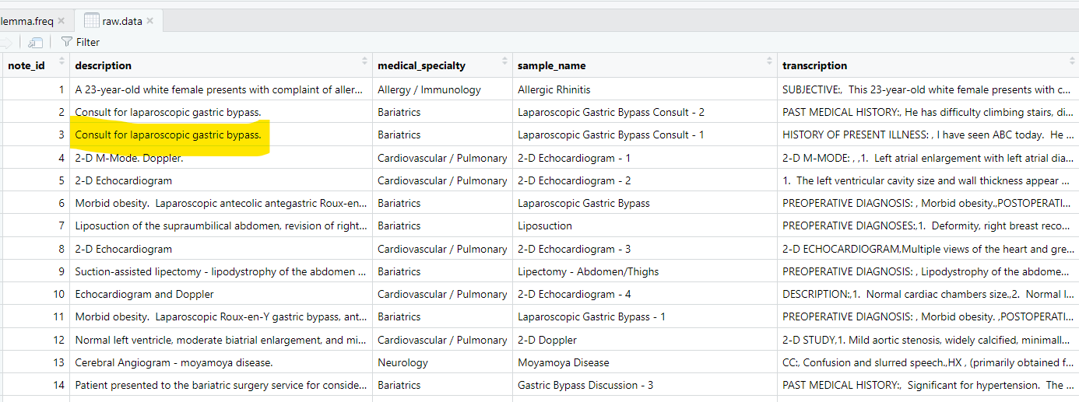
Chatgpt
ChatGPT is an AI language model
It is designed to generate human-like responses in natural language conversations.
Let us ask something

Slide 59
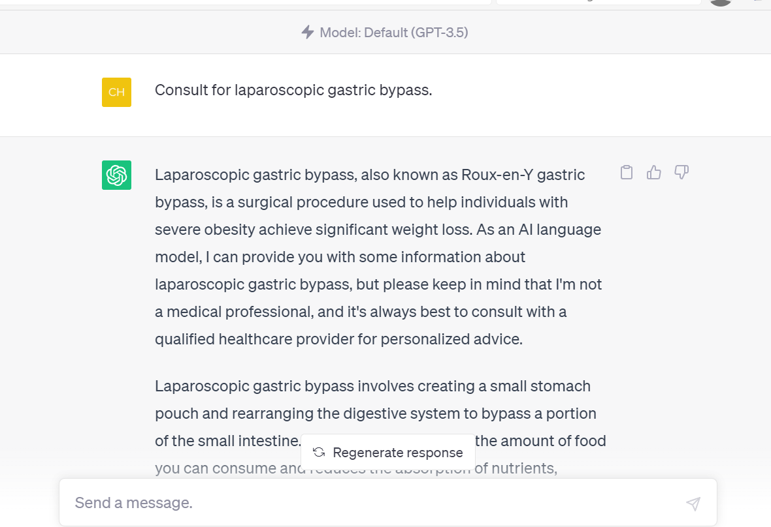
Chatgpt

Slide 60
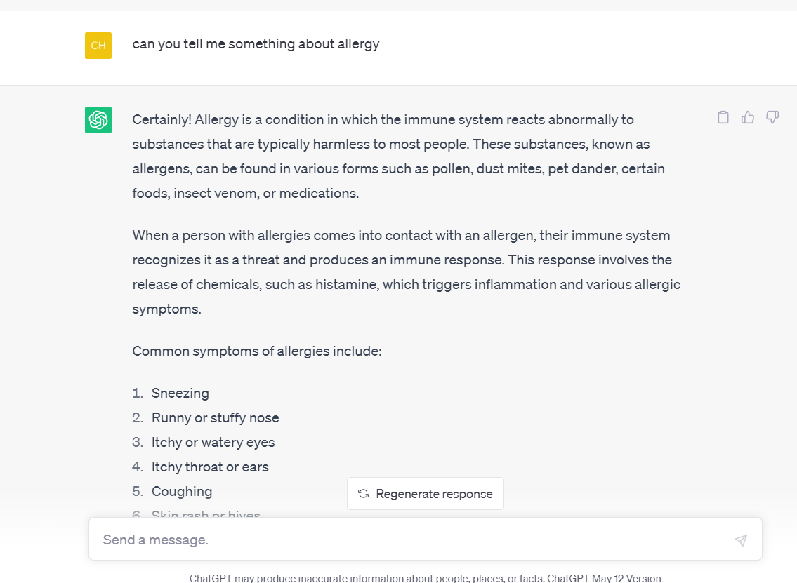
Chatgpt

Slide 61
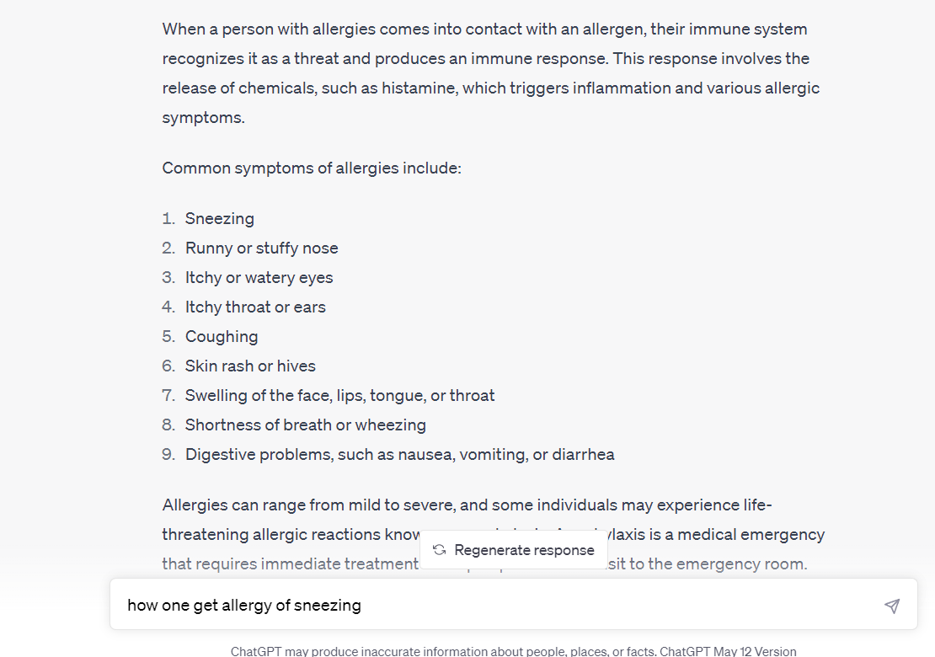
Chatgpt

Slide 62
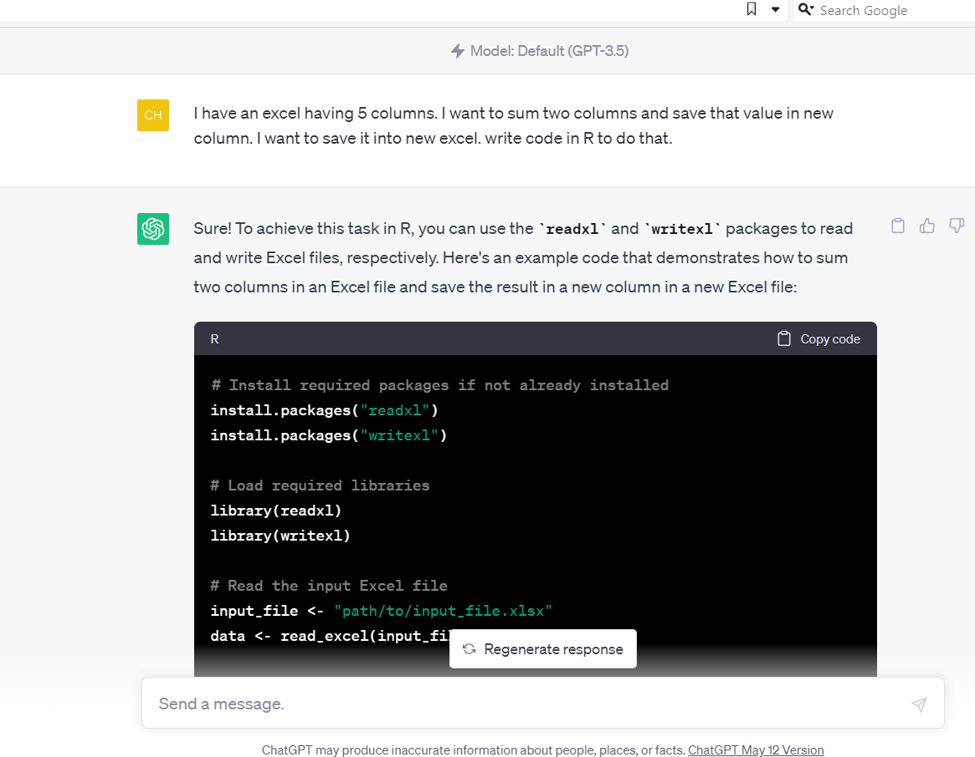
Chatgpt

Slide 63
Overview
Describe electronic medical/health record systems and the types of data they typically contain
Distinguish structured, semi-structured, unstructured text data
Describe approaches to searching text
Outline key steps in preparing text for analysis
Explain the general concept of learnt word embeddings
Explain how embeddings can be tuned/customised
Identify differences between named entity recognition, parts of speech tagging, and dependency parsing
Overview of language models
Not covered: fuzzy search

